Slide 1
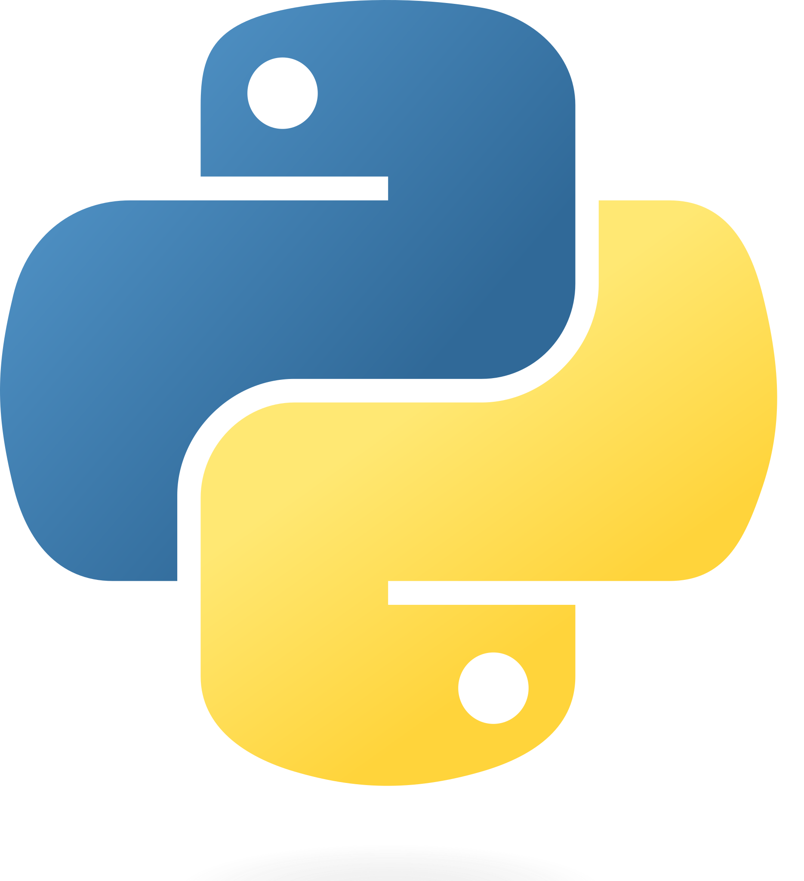
Introduction to Python Level 1

Slide 2
Day 1 Day 2
Why Python?
Python history
Python Installation
Python IDE
Python comment
Python variable
Python Data types
Operators
Operator Precedence
If… else
Loops
Functions
Creating Python Programs
Write your first code
Analyze the code
Pip
Python modules

Slide 3
Why Python?
Python is one of the world’s most used and most popular programming languages. It’s powerful, versatile, and easy to learn. Python is widely used in various applications, some notable ones:
Web development
Data Science
Data analysis
Machine learning
Artificial Intelligence (AI)
Scripting and tooling

Slide 4
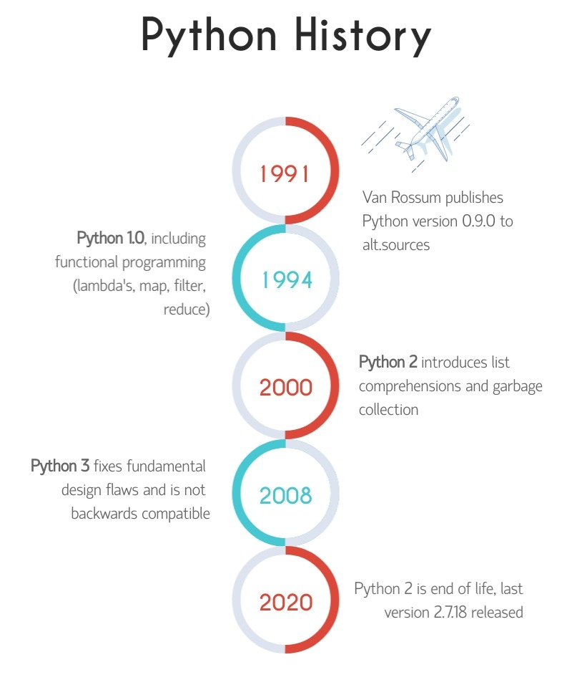
Python history
Python is a computer programming language. Or, in other words, a vocabulary and set of grammatical rules for instructing a computer to perform tasks. Its original creator, Guido van Rossum, named it after the BBC television show ‘Monty Python’s Flying Circus.’
Easy to learn

Slide 5
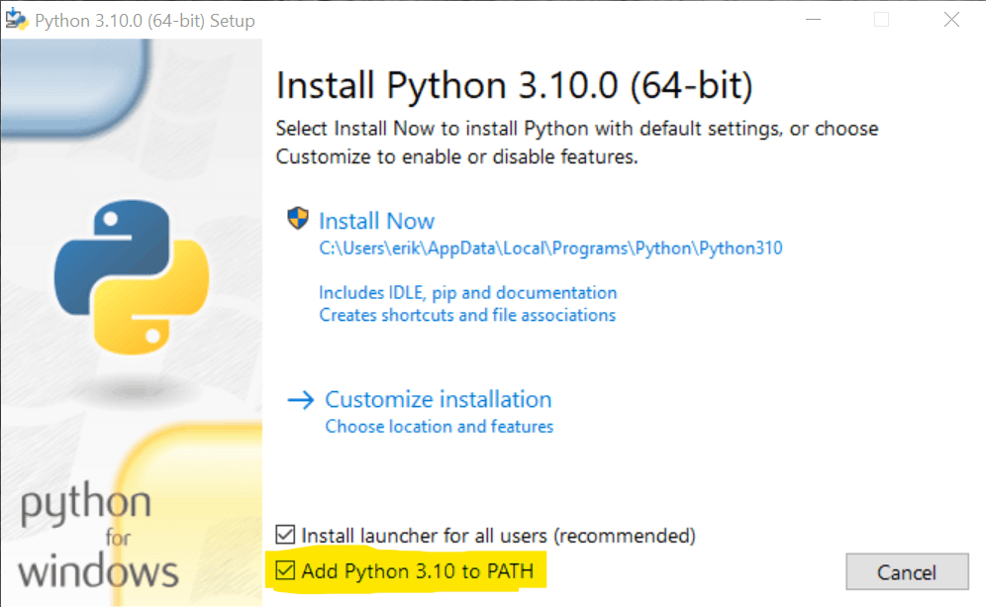
Install Python: Detailed Instructions for Windows and Mac
Install python for Windows
Install python on macOS

Slide 6

Python IDE
Install Anaconda navigator
Install jupyter Notebook through Anaconda

Slide 7
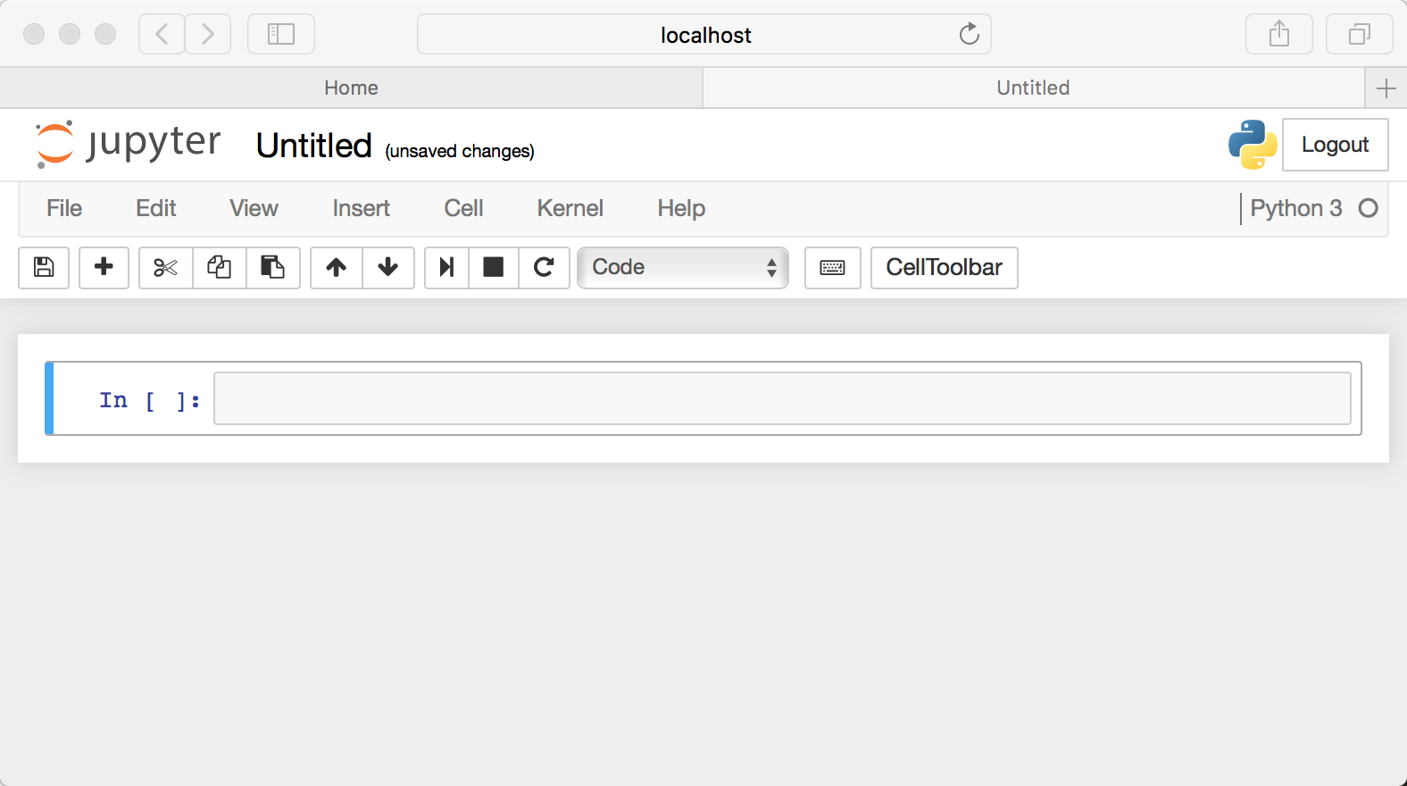
Exploring The Python IDE

Slide 8
Run Your First Python Program
print('Hello world’)
here’s a tradition in which programming tutorials, books, and courses start with a so-called Hello World program. A Hello World program simply prints the words “Hello world” to the screen.
The print() function takes anything you put between the parentheses and prints it to the screen. But we must feed it the correct type of data for it to work. For example, we need to put text in Python between quotes. In the world of computer programming, we call this a string.

Slide 9
Python Comment: What It Is And How to Create
A comment is an explanation in the source code of a Python program. Comments are added with the purpose of making source code easier for humans to understand. They are ignored by the Python interpreter.
A single-line Python comment
# This is a single-line comment in Python
print('Hello’)
# And here's another one!
Multiline Python comment
# This is a multi-line comment in Python,
# there's not much difference with single-
# line comments, as you can see!
Commenting code is a best practice.

Slide 10
Python Variable: Storing Information for Later Use
A variable is used to store information that can be referenced later on.
Declaring a Python variable
Variable naming
Using variables in expressions
Variable type
Valid Python variable names

Slide 11
Python Data Types
Integers
Floating point numbers
Complex numbers
Booleans
Strings
Tuples
Lists
Ranges
Dictionaries
Sets

Slide 12

Python Integer: Non-Fractional Numbers
The Python integer is a non-fractional number, like 1, 2, 45, -1, -2, and -100. It’s one of the three types of numbers Python supports natively, the others being floating point numbers and complex numbers.
Max size of a Python integer
Converting from and to an integer
String to integer
Float to integer
Python random integer

Slide 13

Python Float: Working With Floating-Point Numbers
A floating-point number is a number with a decimal point or exponent notation, indicating that a number is a certain number of digits before and after the decimal point or exponent. For example, the number 1.23 is a floating-point number with one digit before the decimal point and two digits after the decimal point.
Creating floating point numbers
f = 1.45
# f will become 2.0 in all cases below
f = float(2.0)
f = float(2)
f = float("2")

Slide 14
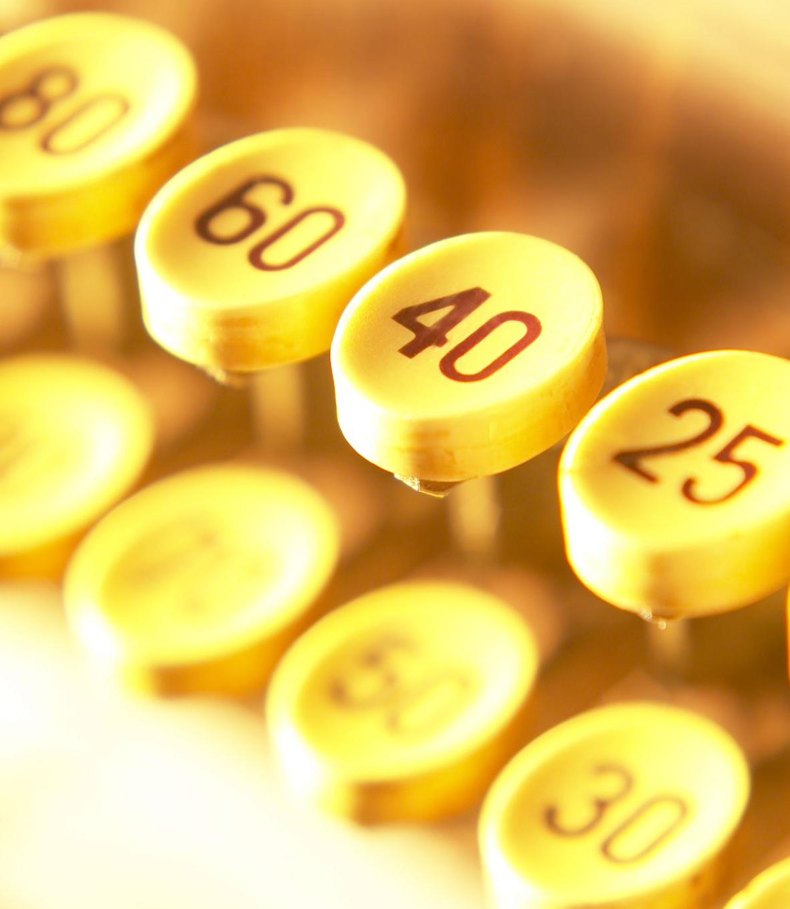
Complex Numbers
The complex data type in python consists of two values, the first one is the real part of the complex number, and the second one is the imaginary part of the complex number.
x = 3+5j y = 5j z = -5j print(type(x)) print(type(y)) print(type(z))

Slide 15

Boolean
A boolean is the simplest data type; it’s either True or False.
In computer science, booleans are used a lot. This has to do with how computers work internally. Many operations inside a computer come down to a simple “true or false.” It’s important to note, that in Python a Boolean value starts with an upper-case letter: True or False. This is in contrast to most other programming languages, where lower-case is the norm.
door_is_locked = True
if door_is_locked:
print("Mum, open the door!")

Slide 16
Python String: Working With Text
Escaped sequence | What is does
\n | A newline (Newlines are generated with your return key). Advances to the next
\r | Carriage return: takes you back to the start of the line, without advancing to the next line
\t | A tab character
\\ | The slash character itself: because it is used as the start of escape sequences, we need to escape this character too. Python is quite forgiving if you forget to escape it, though.
A string in Python is a sequence of characters.
How to create a Python string
Single or double quotes?
Multiline strings

Slide 17
Python String: Working With Text
Using triple quotes for escaping
String operations
Example –
>>> mystring.lower()
'hello world'
>>> mystring.upper()
'HELLO WORLD'

Slide 18

Python string formatting with f-strings
A common pattern is the need to merge some text strings together or use a variable inside your string. There are several ways to do so, but the most modern way is to use f-strings, short for formatted strings.
Let’s first look at an example before we dive into the details:
>>> my_age = 40
>>> f'My age is {my_age}'
My age is 40

Slide 19
Python Tuple: How to Create, Use, and Convert
A Python tuple is one of Python’s three built-in sequence data types, the others being lists and range objects. A Python tuple shares a lot of properties with the more commonly known Python list:
It can hold multiple values in a single variable
It’s ordered: the order of items is preserved
A tuple can have duplicate values
It’s indexed: you can access items numerically
A tuple can have an arbitrary length
But there are significant differences:
A tuple is immutable; it can not be changed once you have defined it.
A tuple is defined using optional parentheses () instead of square brackets []
Since a tuple is immutable, it can be hashed, and thus it can act as the key in a dictionary

Slide 20
Python Tuple: How to Create, Use, and Convert
Creating a Python tuple
Multiple assignment using a Python tuple
Indexed access
Append to a Python Tuple
Get tuple length
Converting Python tuples

Slide 21
Python List: How To Create, Sort, Append, Remove, And More
The Python list is one of the most used data structures, together with dictionaries. The Python list is not just a list but can also be used as a stack and even a queue.
How to create a Python list
Using the list() function
Accessing Python list elements
Get the last element of a list
Accessing nested list elements
Adding and removing elements
Append to a Python list
Combine or merge two lists
Pop items from a list
Remove specific values from a Python list
Remove or clear all items from a Python list
Remove duplicates from a list
Sorting Python lists

Slide 22
Python range() Function
Python’s range acts as a built-in function and is commonly used for looping a specific number of times in for-loops. Like many things in Python, it’s actually a Python type (or class), but when using it in a loop, we can treat it like a built-in function that returns an iterable object.
Example –
for i in range(0, 6, 2):
print(i, end=" ")
# Output will be: 0 2 4

Slide 23

Python Dictionary
The Python dictionary is one of the language’s most powerful data types. In other programming languages and computer science in general, dictionaries are also known as associative arrays. They allow you to associate one or more keys to values. If you are familiar with JSON, you might feel right at home. The syntax of a dictionary strongly resembles the syntax of a JSON document.
Creating a Python Dictionary
Example –
phone_numbers = { 'Jack': '070-02222748',
'Pete': '010-2488634',
'Eric': '06-10101010' }
names = phone_numbers.keys()
numbers = phone_numbers.values()

Slide 24
Built-in Python dictionary methods
Method | What is does | Example
clear() | Remove all key/value pairs (empty the dictionary) | phone_numbers.clear()
get(key) | Get a single item with the given key, with an optional default value | phone_numbers.get('Martha', 'Unknown person')
items() | Returns a view object containing key-value pairs from the dictionary | phone_numbers.items()
keys() | Returns a view object with a list of all keys from the dictionary | phone_numbers.keys()
values() | Returns a view_object with a list of all values from the dictionary | phone_numbers.values()
pop(key, default_value) | Returns and removes the element with the specified key | phone_numbers.pop('Martha')
popitem() | Returns and removes the last inserted item (Python 3.7+) or a random item | phone_numbers.popitem()
setdefault(key, value) | Returns the value of the specified key. If the key does not exist, it’s inserted with the given value | phone_numbers.setdefault('John Doe', 1234)
update(iterable) | Add all pairs from given iterable, e.g. a dictionary | phone_numbers.update({"Alina": 1234, "Alice", 2345})

Slide 25

Python Set
A Python set is a collection of distinct elements. The set has some things in common with Python lists and tuples, but there are important differences:
A Python set can only contain unique values
Sets are unordered
More formally: sets are unordered collections of distinct objects. In this article, we’ll closely examine sets and how to use them. I’ll focus more on the extras that a set has to offer than on the basics that are the same for lists and other sequence types.
How to create a Python set
names = { "Eric", "Ali", "John" }
# Mixed types are allowed
mixed_set = { 'a', 1, (1, 2) }

Slide 26
Operators
Operators are used to perform operations on variables and values.
In the example below, we use the + operator to add together two values:
print(10 + 5)
Python divides the operators in the following groups:
Arithmetic operators
Assignment operators
Comparison operators
Logical operators

Slide 27
Arithmetic operators
Operator | Name | Example
+ | Addition | 2 + 2
– | Subtraction | 3 – 1
* | Multiplication | 5 * 3
/ | Division | 5 / 2
Operator | Name | Example
% | Modulo | 5 % 2
// | Floor division | 9 // 2
** | Exponential | 2 ** 4

Slide 28
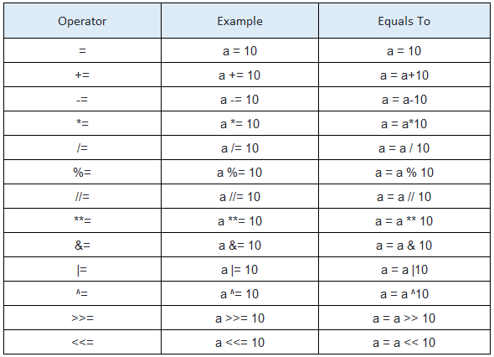
Assignment operators

Slide 29
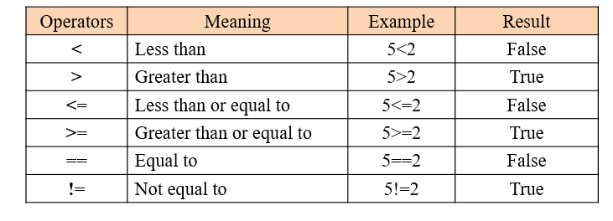
Comparison operators

Slide 30
Logical operators
Operator | What is does | Examples
and | True if both statements are true | True and False == False False and False == False True and True == True
or | True if one of the statements is true | True or False == True True or True == True False or False == False
not | Negates the statement that follows | not True == False not False == True
These operators only work on booleans and are used to implement logic. The following table lists and describes them:

Slide 31
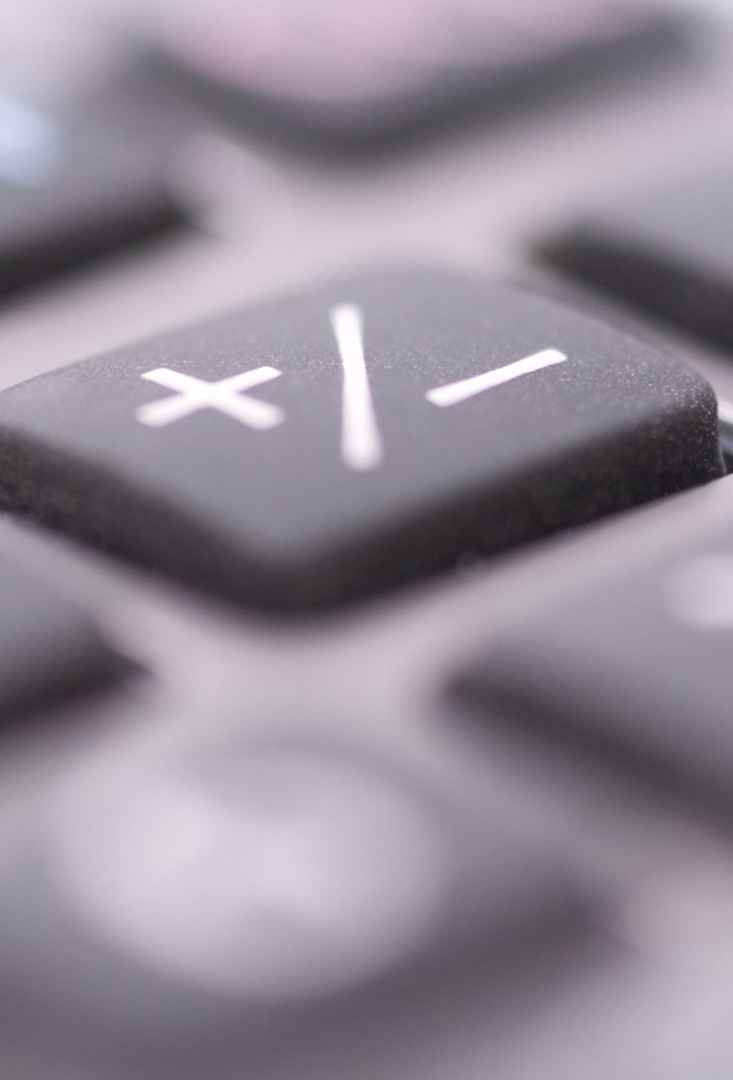
Operator precedence
Operator precedence describes the order in which operations are performed. Python processes the operators and numbers similar to regular math. For example, multiplication and division come before addition and subtraction. However, in Python multiplication and division have the same precedence, so the order matters too. E.g., 2 * 2 / 8 = 0.5 , while 2 / 2 * 8 = 8.0.
Notes:
Ask for example calculations. Can be a quiz

Slide 32
Conditional Programming: if.. else
Python supports the usual logical conditions from mathematics:
Equals: a == b
Not Equals: a != b
Less than: a < b
Less than or equal to: a <= b
Greater than: a > b
Greater than or equal to: a >= b
These conditions can be used in several ways, most commonly in "if statements" and loops.
An "if statement" is written by using the if keyword.
Example:
a = 10 b = 20 if b > a: print("b is greater than a")

Slide 33
Conditional Programming: if.. else
Python relies on indentation (whitespace at the beginning of a line) to define scope in the code. Other programming languages often use curly-brackets for this purpose.
Elif : The elif keyword is Python's way of saying "if the previous conditions were not true, then try this condition".
Else : The else keyword catches anything which isn't caught by the preceding conditions.
Examples:
a = 33 b = 33 if b > a: print("b is greater than a") elif a == b: print("a and b are equal")
a = 200 b = 33 if b > a: print("b is greater than a") elif a == b: print("a and b are equal") else: print("a is greater than b")

Slide 34

Python For Loop and While Loop
Python For-loop
Python for-loops and lists
Python While-loop
Infinite loops
Getting out of an Infinite loop
Notes:
Make student write an example of their own after explaining

Slide 35

Python Function: The Basics Of Code Reuse
A Python function is a named section of a program that performs a specific task and, optionally, returns a value
Advantages of using functions
Code reuse
Return values
Parameters

Slide 36
Python functions
Built-in Python functions
Creating a Python function
Indentation
Python function parameters and arguments
Returning from a function
Returning values
Notes:
Make student write an example of their own after explaining

Slide 37
Creating Python Programs
Create
Create a Python file
Enter
Enter the code
Save
Save the file
Execute
Execute a Python program file

Slide 38
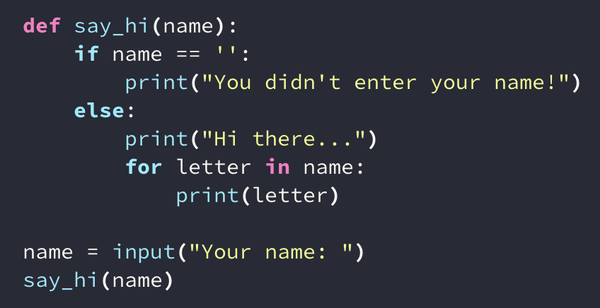
Your First Python Program
Notes:
Tell students to do in notebook

Slide 39
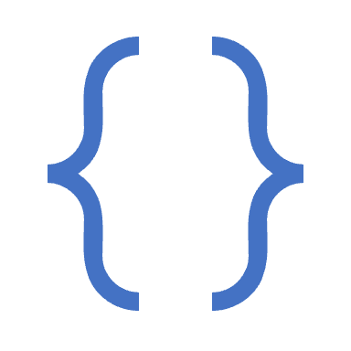
Analyzing your first Python program
Asking for input with Python
The say_hi function with one argument
An if .. else block
A for loop
Notes:
Analyze each line step by step

Slide 40
Pip
Pip install is the command you use to install Python packages with the Pip package manager. If you’re wondering what Pip stands for, the name Pip is a recursive acronym for ‘Pip Installs Packages.’ There are two ways to install Python packages with pip.
Notes:
Tutorial example to install and use

Slide 41

Python Modules: Bundle Code And Import It From Other Files
What is a module?
Python import
Importing specific parts of a Python module
Valid Python module names
Notes:
Detailed explanation with examples such as pandas or stats

Slide 42
More websites to learn python
https://docs.python.org/3/tutorial/
https://www.w3schools.com/python/
https://www.tutorialspoint.com/python/index.htm
https://www.learnpython.org/

Slide 43
